Slide 1
SportsPlex
Presented By: Edward Marks, Peter Kowalski, Matt Degraeve, Anthony Saleh, Graydon Peck, Colin Neil

Slide 2
Goal:
To create a website for a hockey complex with rink rentals, skate sharpening, equipment sales, and employee management functionality (View work schedule, location, etc.)

Slide 3
Requirements
Req1: New users can register
Req2: A Manager can create an employee account
Req3: A Manager can assign employees to stations
Req4: An Employee can manage service queue
Req5: A customer can view ice rink reservation times and dates
Req6: A customer can reserve a spot in the facility
Req7: An employee can view their schedule

Slide 4
Requirements Continued
Req8: Returning users obtain secure logins
Req9: Customers are shown upon logging in what interests them (recently view items or purchases).
Req10: Returning users can see recently viewed rink times (must sign in).
Req11: Admins monitor new user entries.

Slide 5
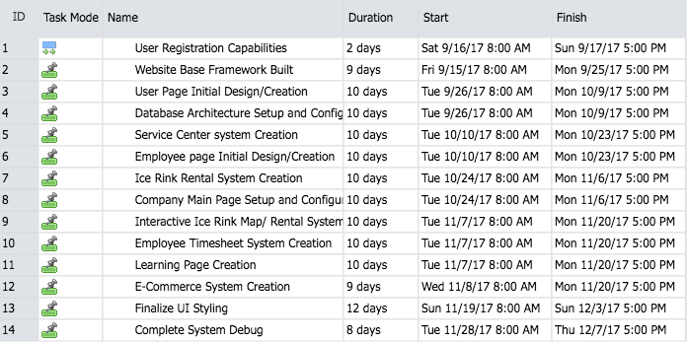
Project Plan

Slide 6
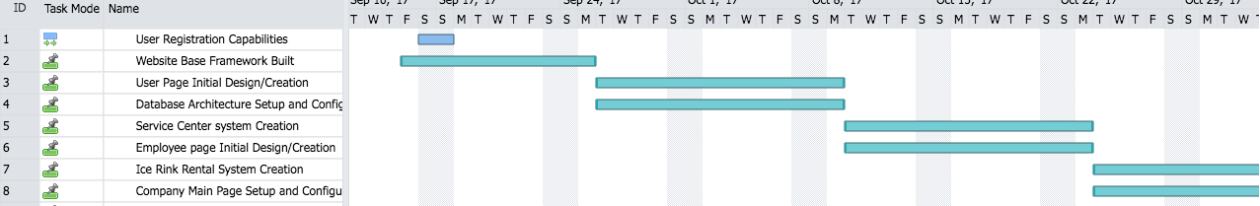
Project Plan Cont.

Slide 7
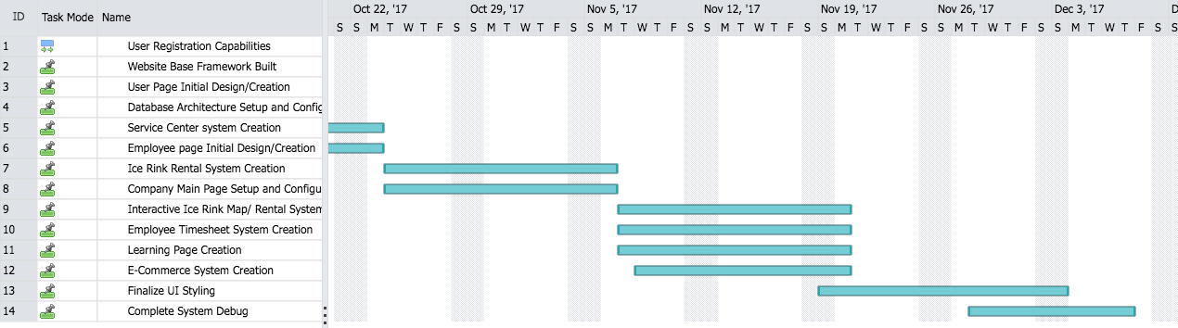
Project Plan Cont.

Slide 8
Tools / Languages / Etc.
HTML/PHP/CSS
Cloud9
phpMyAdmin integrated with Cloud9 (or MySQL)
GitHub (GitHub Desktop, Command line, C9 integration)
JavaScript
JQuery

Slide 9
END

